Slide 1

শিক্ষা নিয়ে গড়বো দেশ তথ্য-প্রযুক্তির বাংলাদেশ
Bangabandhu Sheikh Mujibur Rahman Digital University, Bangladesh
Department: Internet of Things and Robotics Engineering (IRE)
Title: 3rd Generation Partnership Project(3GPP)
Presented by
Name- Srabonee Paul, Koushik Biswas, Kishor Kumar Bormon
ID: 2101015, 2101029, 2101045
Department of IRE
Session : 2021-2022
Bangabandhu Sheikh Mujibur Rahman
Digital University, Bangladesh
Supervised by
Saurav Chandra Das
Lecturer
Department of IRE,BDU
Bangabandhu Sheikh Mujibur Rahman
Digital University,Bangladesh
02/12/2024
1

Slide 2
Table of Contents:
What is 3GPP
Key 3GPP Standards
Partners and members of 3GPP
A brief evolution of mobile communication systems
UMTS Core Network Evolution
The 3GPP Release 4 Network Architecture
The 3GPP Release 5 IP Multimedia Domain
3GPP Standards relevant to IoT
Use cases and Comparison
3GPP Release Highlights

Slide 3
3GPP
What is 3GPP?
The 3rd Generation Partnership Project (3GPP) is an international group that develops global standards for mobile networks. It started in 1998 with the goal of creating a universal standard for 3G (third-generation) mobile technology, but its work now includes 4G (LTE) and 5G standards. These standards ensure that mobile networks and devices can work together worldwide.

Slide 4
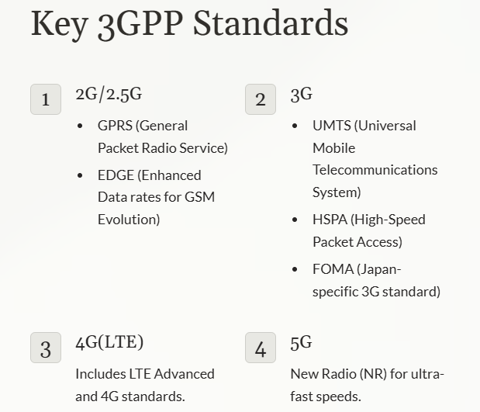


Slide 5
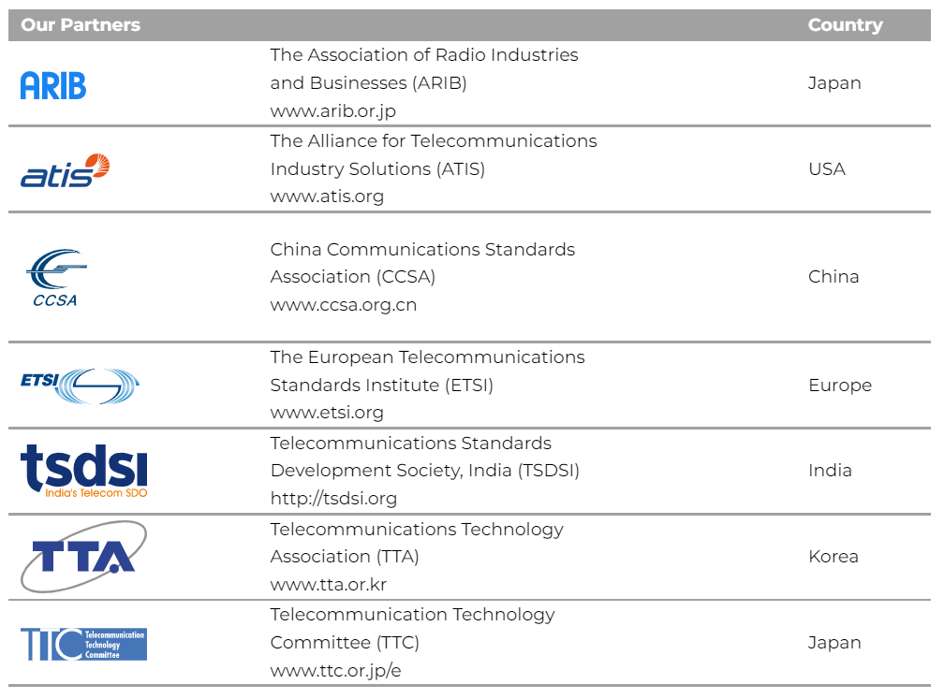
Who are the partners and members of 3GPP?

Slide 6
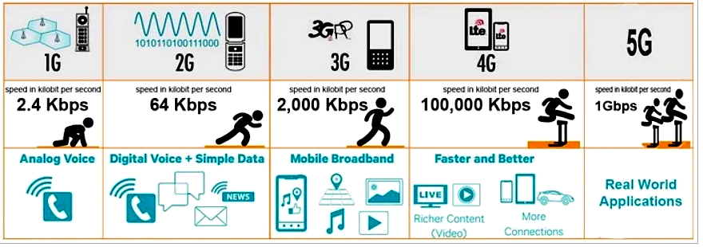
A brief evolution of mobile communication systems

Slide 7
3GPP Release Highlights
Release 8
Introduced the first LTE standard and all-IP network.
Release 10
LTE-Advanced, the first standard to meet 4G requirements, was introduced.
Release 15
5G made its debut with focus on mobile broadband for nonstandalone 5G architecture.
Release 17 Enhances features from previous 5G releases and includes satellite access and battery health improvements.

Slide 8
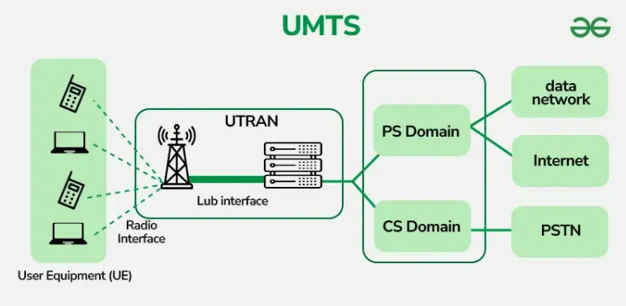
UMTS Core Network Evolution
1. The core network architecture for 3GPP Release 1999 is not greatly different than the core network architecture of GSM/GPRS.
2. It must be upgraded to support the new interface to the radio access network
3. 3GPP Release 4 and 3GPP Release 5 - significant enhancements to the core network

Slide 9
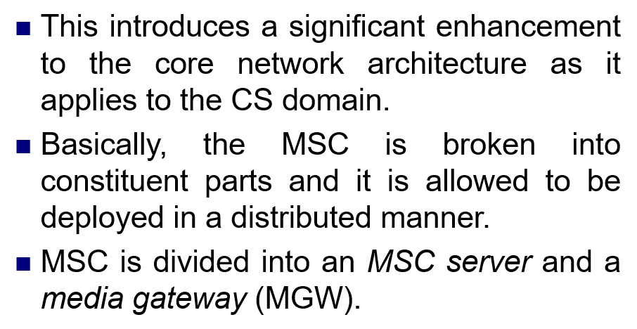
The 3GPP Release 4 Network Architecture

Slide 10
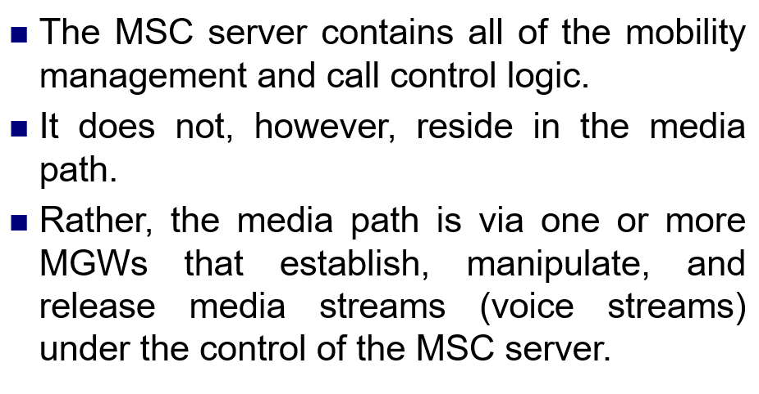
The 3GPP Release 4 Network Architecture

Slide 11
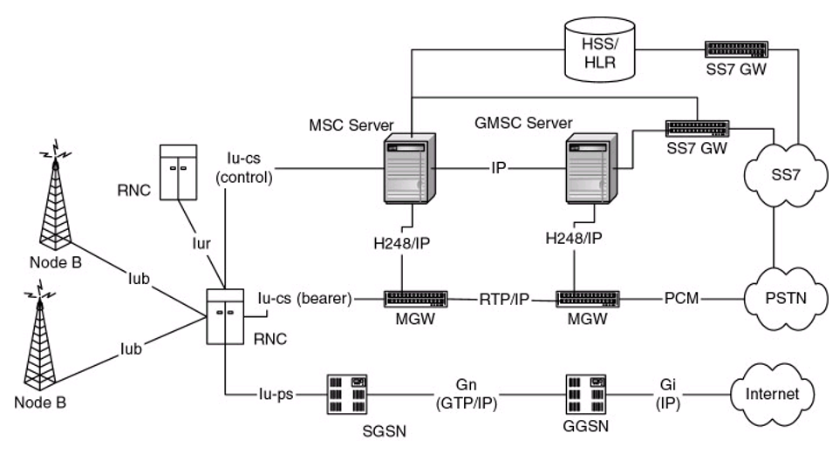
The 3GPP Release 4 Network Architecture

Slide 12
The 3GPP Release 4 Network Architecture
1. Node B:
Function:
Transmits and receives radio signals.
Directly communicates with user devices (mobile phones).
Connection:
Linked to the RNC via the Iub interface.

Slide 13
The 3GPP Release 4 Network Architecture
2. RNC (Radio Network Controller):
Function:
Manages radio resources and mobility.
Controls call setup and handover processes.
Connection:
Connects to Node B via the Iub interface and to other RNCs via the Iur interface.
Communicates with the MSC Server through Iu-cs (control) and Iu-cs (bearer) interfaces.

Slide 14
The 3GPP Release 4 Network Architecture
3. MSC Server (Mobile Switching Center Server):
Function:
Handles call control, mobility management, and signaling.
Focuses only on control signaling, not media streams.
Connection:
Linked to MGW via the H.248/IP protocol.
Interfaces with RNC through Iu-cs (control).

Slide 15
The 3GPP Release 4 Network Architecture
4. MGW (Media Gateway):
Function:
Manages media streams (voice/data transport).
Converts media between PSTN and IP networks.
Connection:
Connected to the MSC Server via H.248/IP protocol.
Uses RTP/IP for media transport.

Slide 16
The 3GPP Release 4 Network Architecture
5. GMSC Server (Gateway MSC Server):
Function:
Routes calls to the PSTN or other external networks.
Connection:
Interfaces with MGW and SS7 GW.

Slide 17
The 3GPP Release 4 Network Architecture
6. HSS/HLR (Home Subscriber Server/Home Location Register):
Function:
Stores subscriber data and profiles.
Connection:
Linked to MSC Server and other control nodes.

Slide 18
The 3GPP Release 4 Network Architecture
7. SS7 GW (Signaling System 7 Gateway):
Function:
Handles signaling with the PSTN via SS7 protocols.
Connection:
Interfaces with the GMSC and PSTN.

Slide 19
The 3GPP Release 4 Network Architecture
8. PSTN (Public Switched Telephone Network):
Function:
Provides traditional circuit-switched telephony services.
Connection:
Connected to MGW for voice services.

Slide 20
The 3GPP Release 4 Network Architecture
9. SGSN (Serving GPRS Support Node):
Function:
Manages mobile data services.
Handles location and data traffic for mobile devices.
Connection:
Connects to the RNC via Iu-ps interface and to GGSN via Gn (GTP/IP).

Slide 21
The 3GPP Release 4 Network Architecture
10. GGSN (Gateway GPRS Support Node):
Function:
Provides connectivity to the internet or external data networks.
Connection:
Interfaces with the internet via the Gi (IP) interface.

Slide 22
The 3GPP Release 4 Network Architecture

Slide 23
The 3GPP Release 5 IP Multimedia Domain
3GPP Release 5 introduces a new core network domain in addition to the established CS and PS domains.
This new domain is available for new user devices that have the capability and the call model logic needed to take advantage of the new domain
Thus, the UTRAN can now be connected to three different logical core network domains — the CS domain, the PS domain, and the IP Multimedia (IM) domain.

Slide 24
The 3GPP Release 5 IP Multimedia Domain
3GPP Release 5 introduces a new core network domain in addition to the established CS and PS domains.
When a terminal wants to use the services of the core network, it indicates which domain it wants to use.
Existing terminals will continue to request the services of the CS or PS domain. New terminals will also be able to request the services of the IM domain.

Slide 25
The 3GPP Release 5 IP Multimedia Domain
The IM domain is a new domain, it uses the services of the PS domain. All IM traffic is packet based and is transported using PS-domain nodes such as the SGSN and GGSN.
The IM domain is based on the Session Initiation Protocol (SIP).
the Call State Control Function (CSCF) is effectively a SIP proxy. The IM architecture enables voice and data calls to be handled in a uniform manner all the way from the UE to the destination.

Slide 26
The 3GPP Release 5 IP Multimedia Domain
A complete convergence of voice and data takes place, such that voice is simply a type of data with specific QoS requirements.
The use of SIP means that a great deal of service control can be placed in the UE rather than the network, making it easier for the subscriber to customize services to meet his or her particular needs.

Slide 27
3GPP Standards
3GPP standards relevant to IoT across LTE-M, NB-IoT, EC-GSM, and 5G.
i. LTE-M (Long-Term Evolution for Machines)
3GPP Release: Introduced in Release 13 and enhanced in subsequent releases.
Purpose: Designed to enable medium-to-high throughput IoT applications with mobility and voice support.

Slide 28
i. LTE-M (Long-Term Evolution for Machines)
Key Features:
Mobility Support: Handles handovers between cells, suitable for mobile use cases.
VoLTE Support: Enables voice calls over LTE.
Coverage Enhancement: Achieves better signal penetration for challenging environments.
Low Power Features:
Power Saving Mode (PSM).
Extended Discontinuous Reception (eDRX).
Use Cases:
Smart metering, and smart transportation.

Slide 29
ii. NB-IoT (Narrowband IoT)
3GPP Release: Also introduced in Release 13 and enhanced in later releases.
Purpose: Focuses on ultra-low-power and cost-sensitive IoT applications with low data rates.
Key Features:
Narrowband Operation: Requires only 180 kHz bandwidth.
Low Cost and Complexity: Simplified device hardware and reduced modem complexity.
Power Efficiency:
Long battery life (up to 10 years).
Supports PSM and eDRX(Extended Discontinuous Reception).
Non-IP Data Delivery (NIDD): Reduces overhead for small data transmissions.

Slide 30
ii. NB-IoT (Narrowband IoT)
Use Cases:
Smart agriculture, asset tracking, environmental monitoring, and remote sensors.

Slide 31
iii. EC-GSM (Extended Coverage GSM for IoT)
3GPP Release: Introduced in Release 13 for IoT support on existing GSM networks.
Purpose: Enables IoT in regions relying on legacy GSM networks, leveraging the established GSM infrastructure.
Key Features:
Extended Coverage: Coverage enhanced by up to 20 dB through retransmissions.
Backward Compatibility: Reuses existing GSM infrastructure with minimal upgrades.
Low Power Modes: Supports PSM and eDRX for energy-efficient operation.
Scalable: Handles a large number of IoT devices on GSM networks.
Low Cost: Reduced complexity for device manufacturing and network implementation.

Slide 32
iii. EC-GSM (Extended Coverage GSM for IoT)
Use Cases:
Rural IoT applications, such as agricultural sensors.

Slide 33
iv. 5G and IoT (Massive IoT, Critical IoT, and Enhanced IoT)
3GPP Releases: Initiated in Release 15 (Phase 1 of 5G) and expanded in Release 16 and beyond. Purpose: Tailored for diverse IoT requirements, from massive device density to real-time critical control.
Key Features:
Massive Machine-Type Communications (mMTC)
Ultra-Reliable Low-Latency Communications (URLLC)
Enhanced Mobile Broadband (eMBB) for IoT
Network Slicing
Use Cases:
Massive IoT: Smart cities, environmental monitoring.
Critical IoT: Industrial automation, autonomous vehicles.
Enhanced IoT: Real-time applications like robotics and immersive media.

Slide 34
Comparison at a Glance:
Feature | LTE-M | NB-IoT | EC-GSM | 5G IoT
Data Rate | Medium | Low | Low | Varies (low to high)
Coverage | Enhanced | Very Enhanced | Enhanced | Flexible
Mobility | Yes | Limited | Limited | Yes
Voice Support | Yes (VoLTE) | No | No | Yes (in some slices)
Latency | Moderate | High | High | Ultra-low (URLLC)
Use Case Scope | Wide | Narrow | Legacy IoT | Comprehensive

Slide 35
Questions
Question 1:
Explain the role of 3GPP in developing global standards for mobile networks. How do these standards contribute to ensuring worldwide compatibility across mobile devices and networks?
Question 2:
Discuss the significance of 3GPP standards in meeting diverse IoT requirements. Highlight how these standards address challenges like device density and real-time critical control.

Slide 36


THANK YOU

